Slide 1


Geographic Information Systems Exploration and Applications
Kristen Vincent ‘14
UW-Madison GIS Certificate Program

Slide 2
Outline
What is GIS?
What is my program?
Natural Science Application
Social Science Application

Slide 3
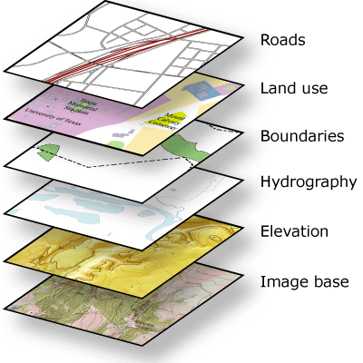
What is GIS?
Geographic Information Systems
Geography Discipline
Computing techniques to represent, manage, and analyze geographic data
More than just computer software: Process:
Conceptualization
Implementation
Layers of Data
desktop.arcgis.com

Slide 4
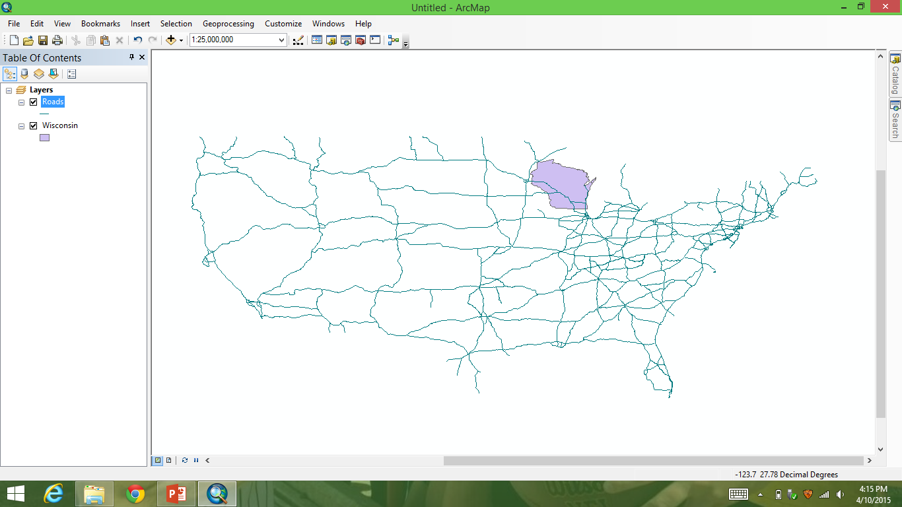
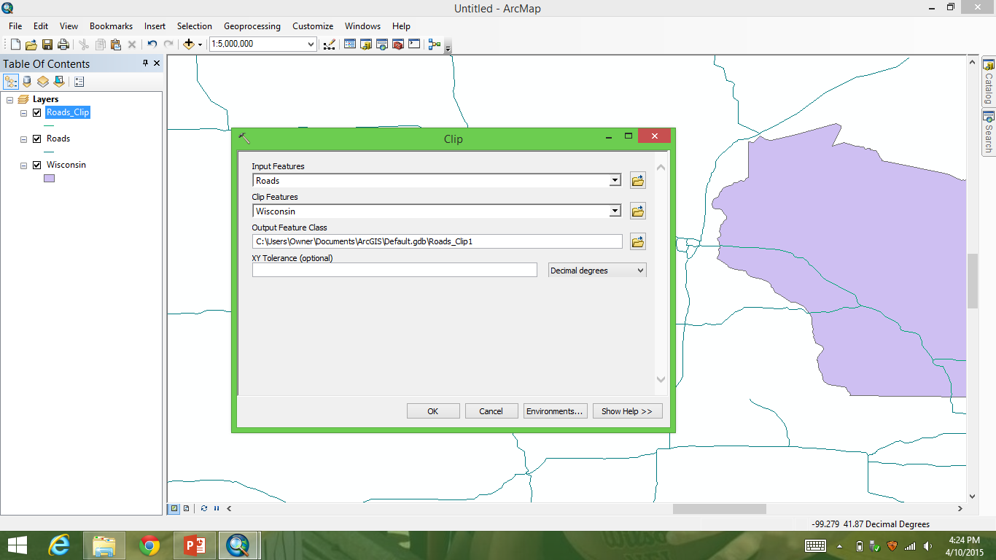
What is GIS?
U.S. Interstate Example
Clip Function

Slide 5
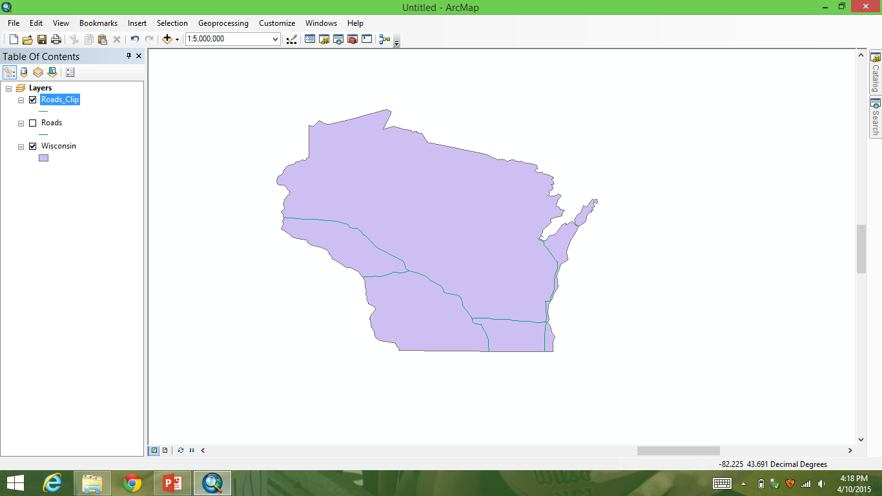
What is GIS?
End result: Interstates in Wisconsin
Many other functions can be performed

Slide 6
GIS Certificate Program
UW-Madison Geographic Information Systems Capstone Certificate Program
-A one year (post-Bachelor Degree) program
-Enhance Bachelor Degree
-Classroom Experience
-Workplace Experience with Capstone Project/Internship
-Workforce or Grad School

Slide 7
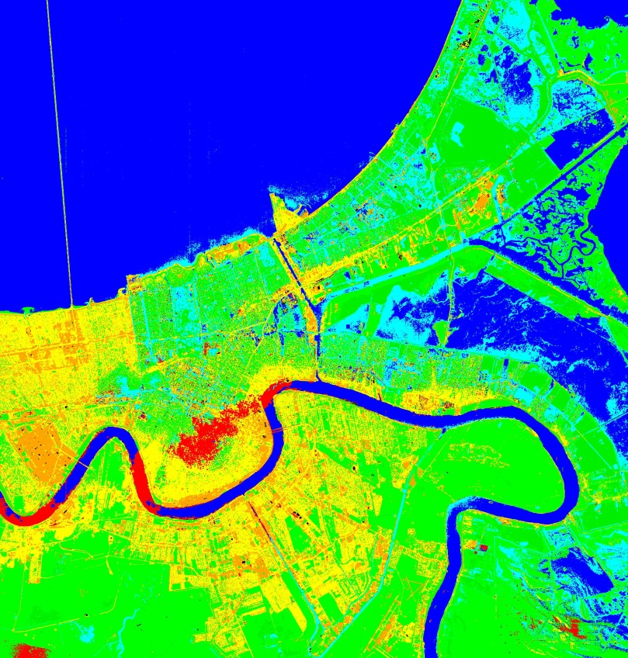
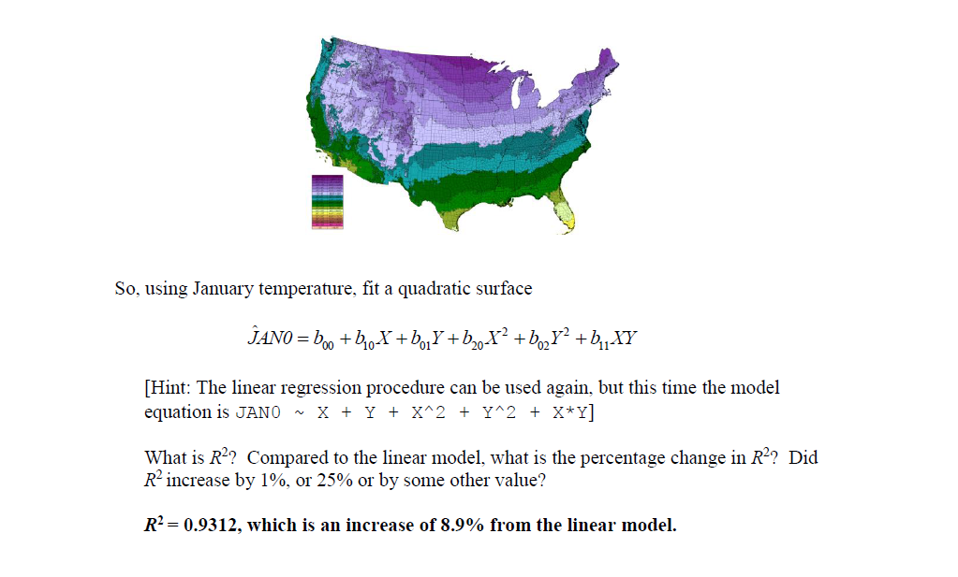
Course Work
Environmental Remote Sensing
Advanced quantitative methods

Slide 8
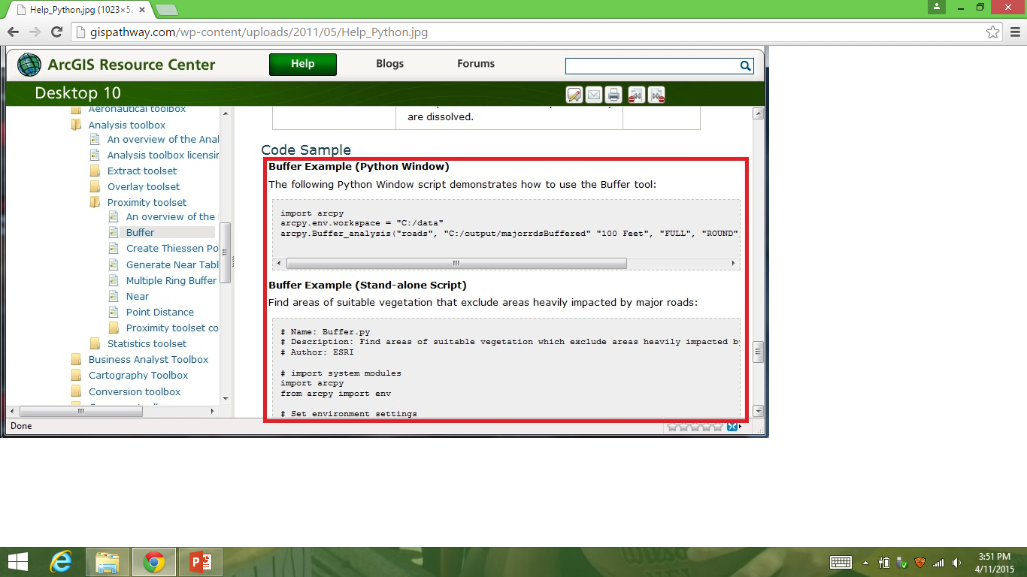
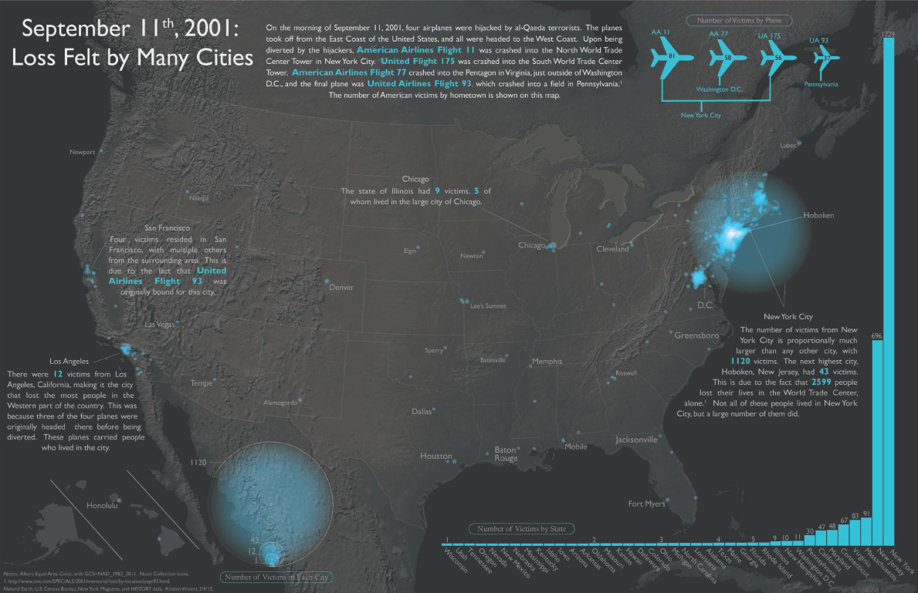
Course Work
Geo-computing
cartography
gispathway.com

Slide 9
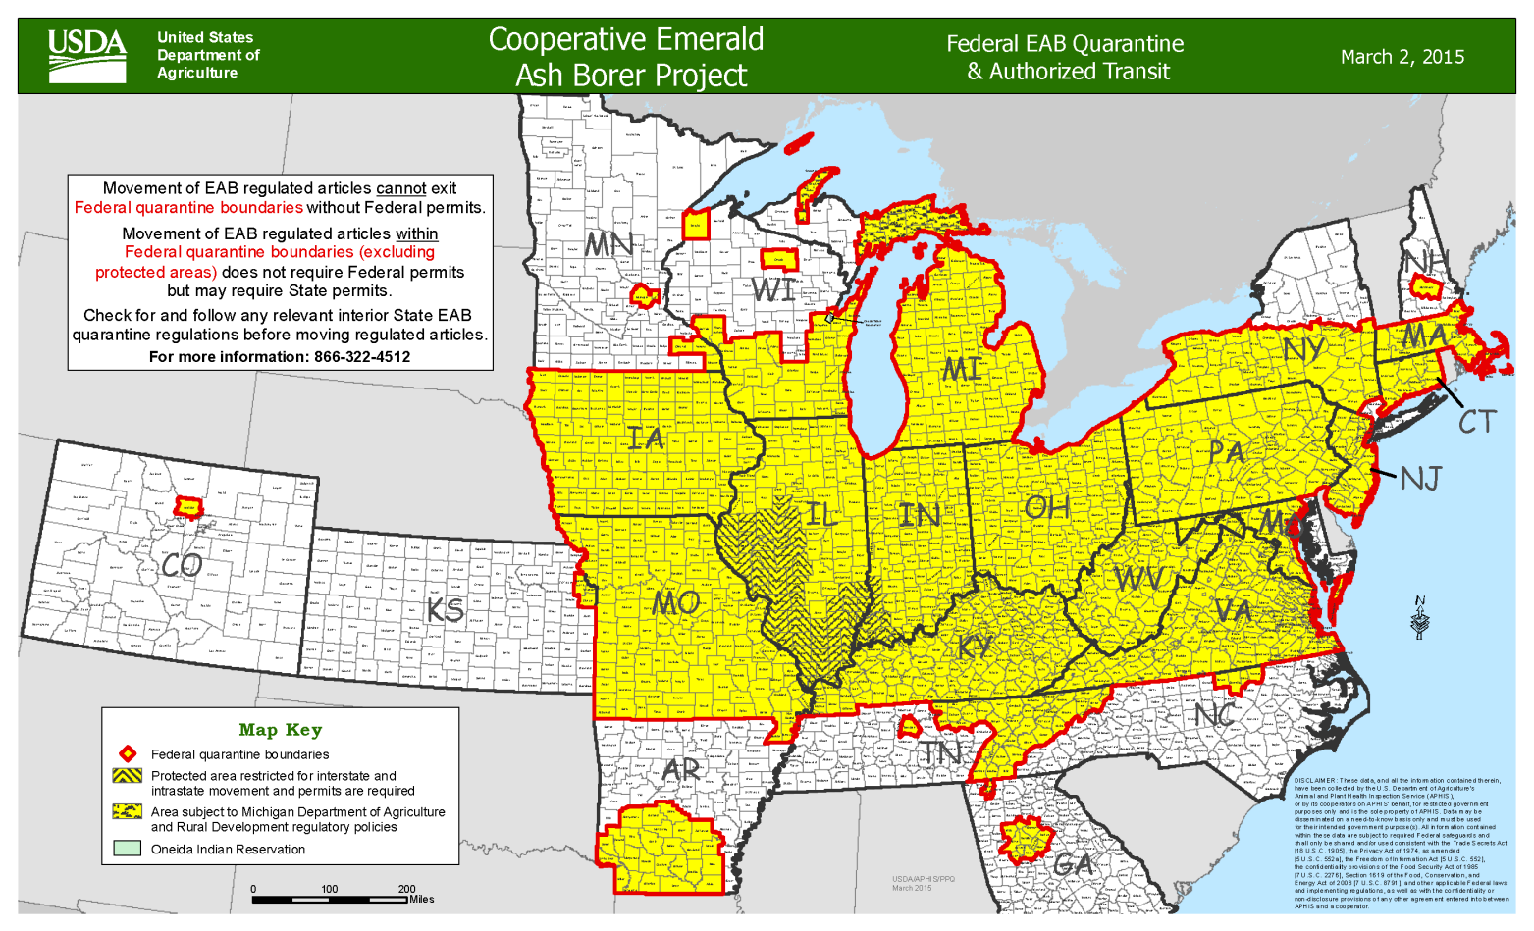
Natural Science Application
Spread of the Emerald Ash Borer
Native to Asia
Came to the U.S. in 2002
Feed on inner bark of ash trees, hindering their ability to transport water and nutrients (USDA)
Environmental and economic effects
aphis.usda.gov

Slide 10
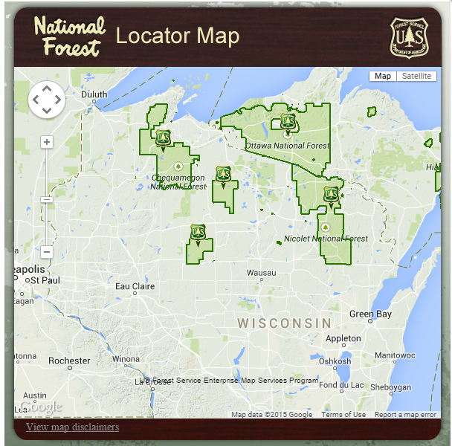
Background
Our research question: How do human activities affect potential future spread of the Emerald Ash Borer within the CNNF?
Study Area-Chequamegon-Nicolet National Forest
Focus on spread from firewood
Can spread through saw mills and nurseries, too
fs.usda.gov

Slide 11
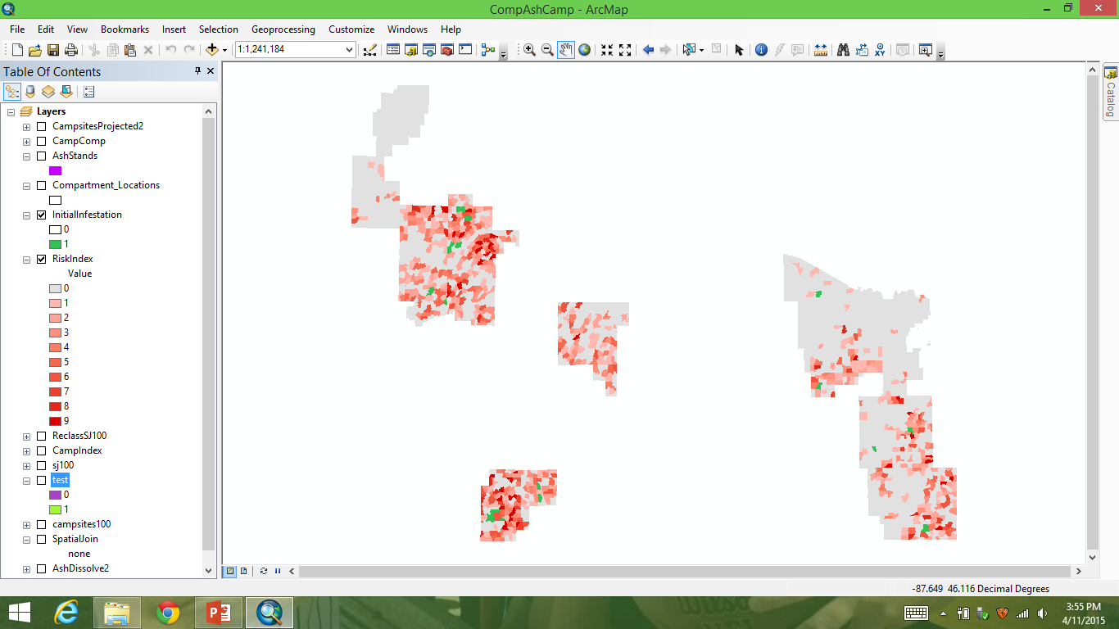
Process
Find campsites
Find compartments with both campsites and ash stands
Code spread radius from campsites/ash stand starting point

Slide 12
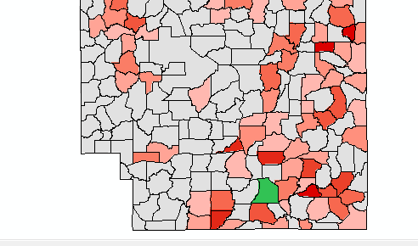
Results
Compartments with
Varying Percentages of Ash Stands
Compartments with Ash Stand
and Campground

Slide 13
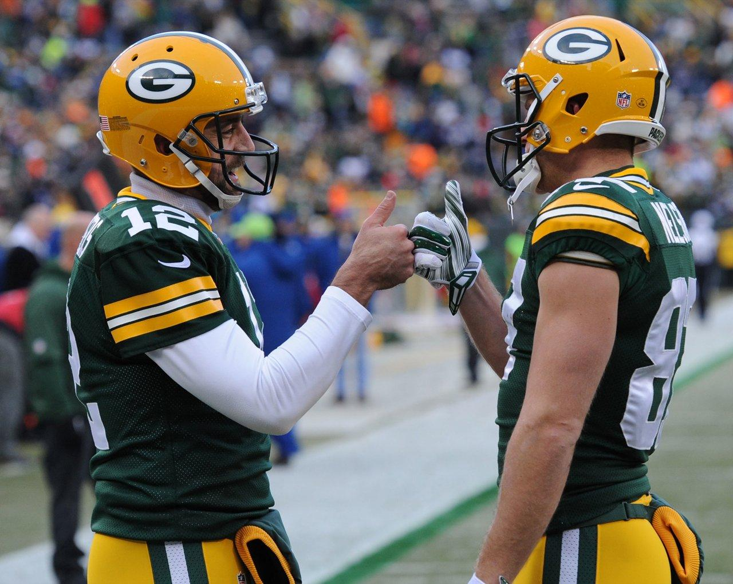

Slide 14
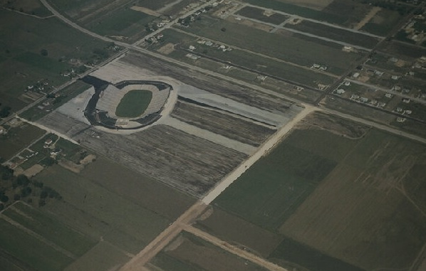
Social Science Application
Site selection for a new City Stadium-1956
New site or current site
Manual survey by Osborn Engineering Company
If GIS were in use at the time, would the result have been the same?
Using GIS to explain the history
packershistory.net

Slide 15
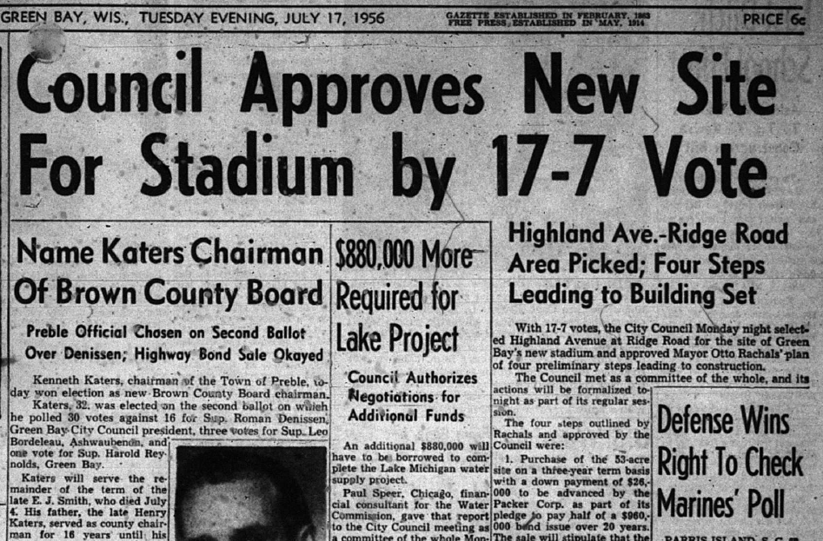
Process
Collect maps of the city from 1956
Define constraints
Soil type
Parking
Ease of accessibility-roads
Soil data
Road data-from maps

Slide 16
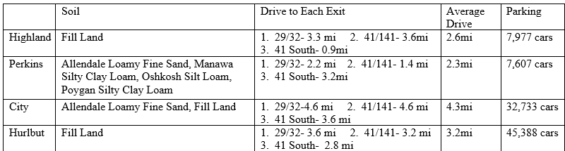
Results

Slide 17
Questions?
Feel free to contact me at kvincent2@wisc.edu

